Slide 1
LLM4TS: PEFT-Enhanced Two-Stage Fine-Tuning of Pretrained LLM for Continuous Time-Series Analysis
Ching (Jason) Chang

Slide 2
Outline
Introduction
Related Work
Solution
Experiments
Conclusion
Future Work

Slide 3
Introduction
The background, the intuition, and the problem we’re solving

Slide 4
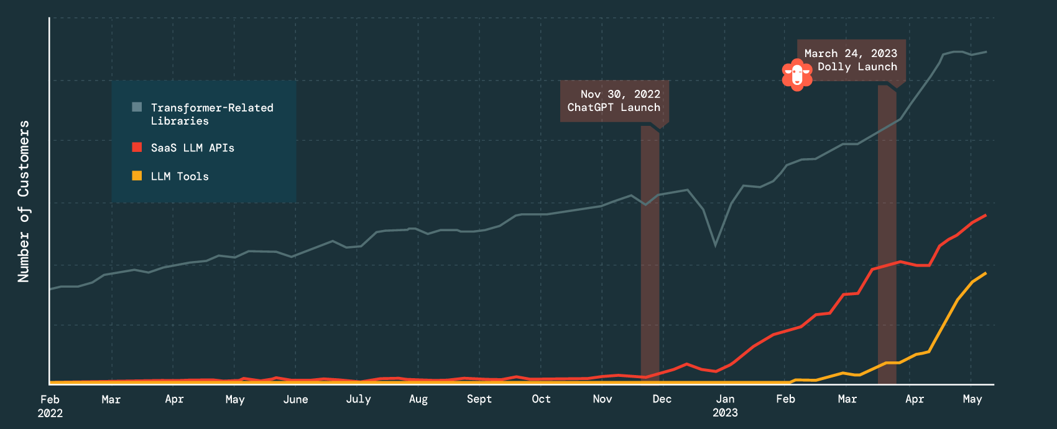
The Usage of Large Language Models (LLMs)
https://twitter.com/matei_zaharia/status/1661044743416184833

Slide 5



Foundation Models in NLP and CV
Universal backbone with task-specific heads for various tasks
LLaMA 2
DINOv2

Slide 6

The Ubiquity of Time-Series
https://cruiseresearchgroup.github.io/project/time-series_forecasting_and_segmentation/

Slide 7
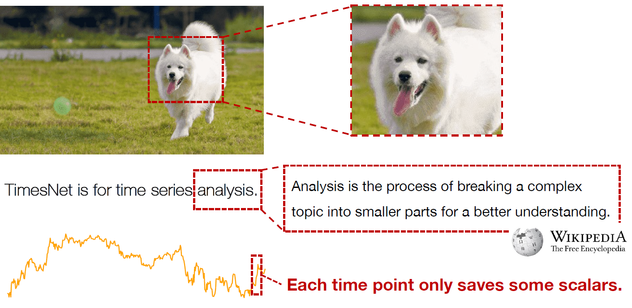
Differences among Image, Language, and Time-Series
https://wuhaixu2016.github.io/pdf/ICLR2023_TimesNet.pdf

Slide 8
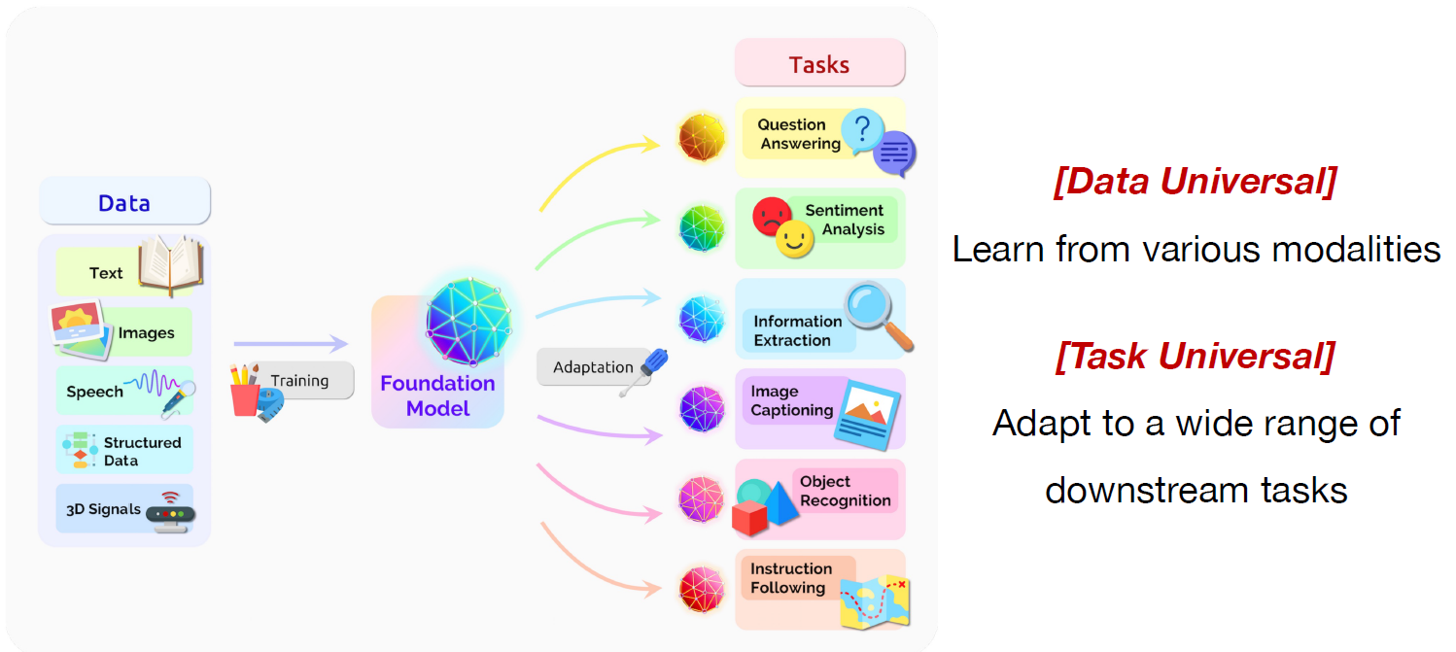
In Pursing Foundation Models
Can time-series be part of this?
https://wuhaixu2016.github.io/pdf/ICLR2023_TimesNet.pdf

Slide 9
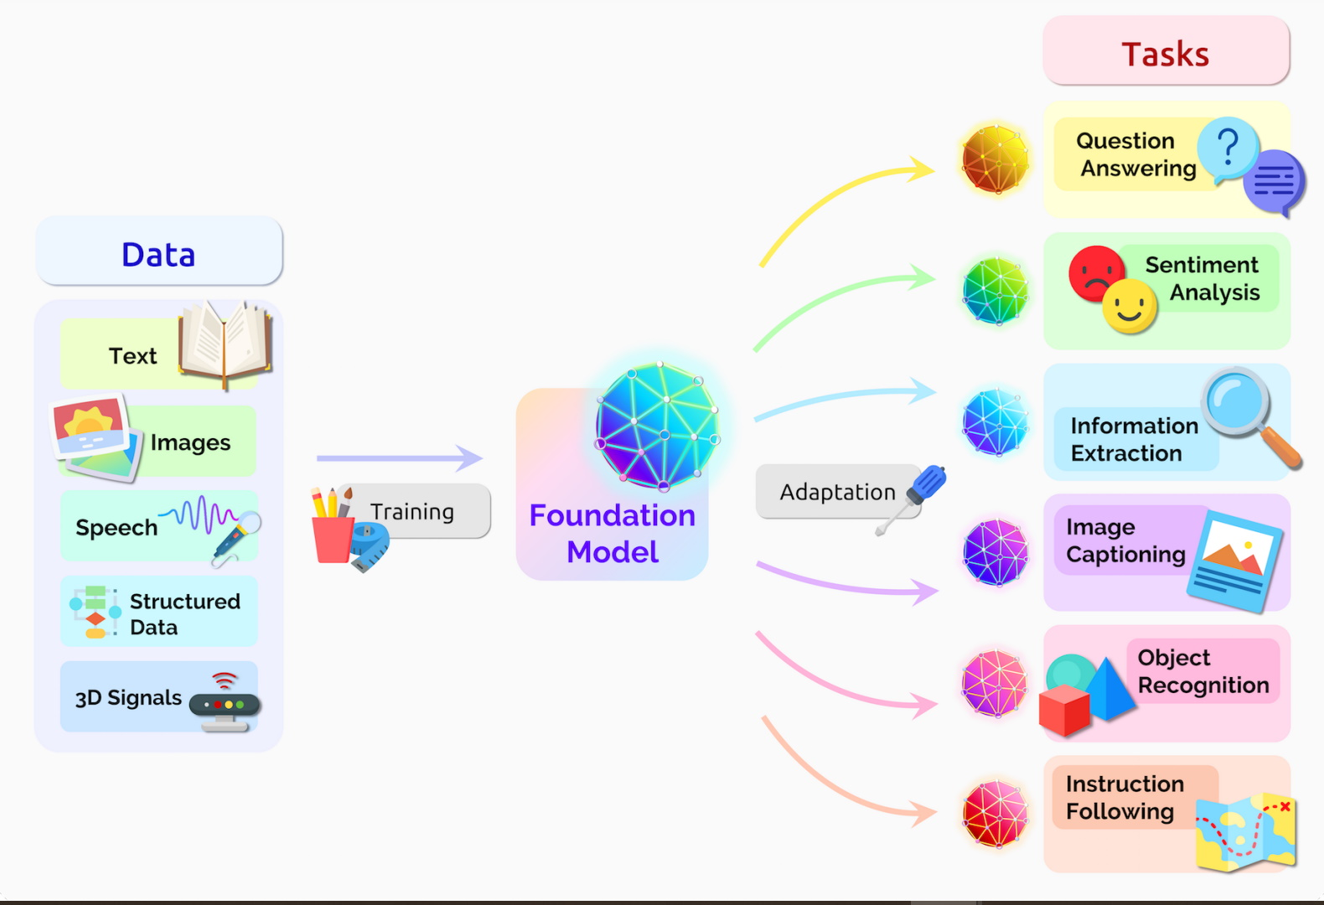

Exploring Foundation Models: Integrating Time-Series Analysis
Time-series
https://blogs.nvidia.com/blog/2023/03/13/what-are-foundation-models/

Slide 10
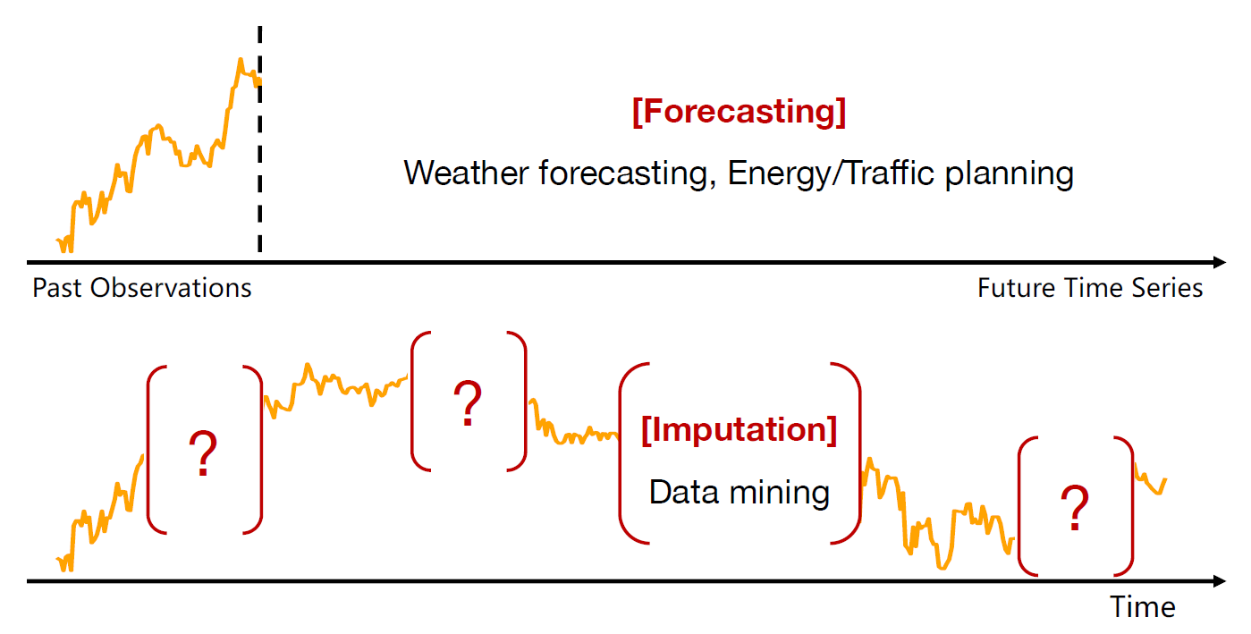
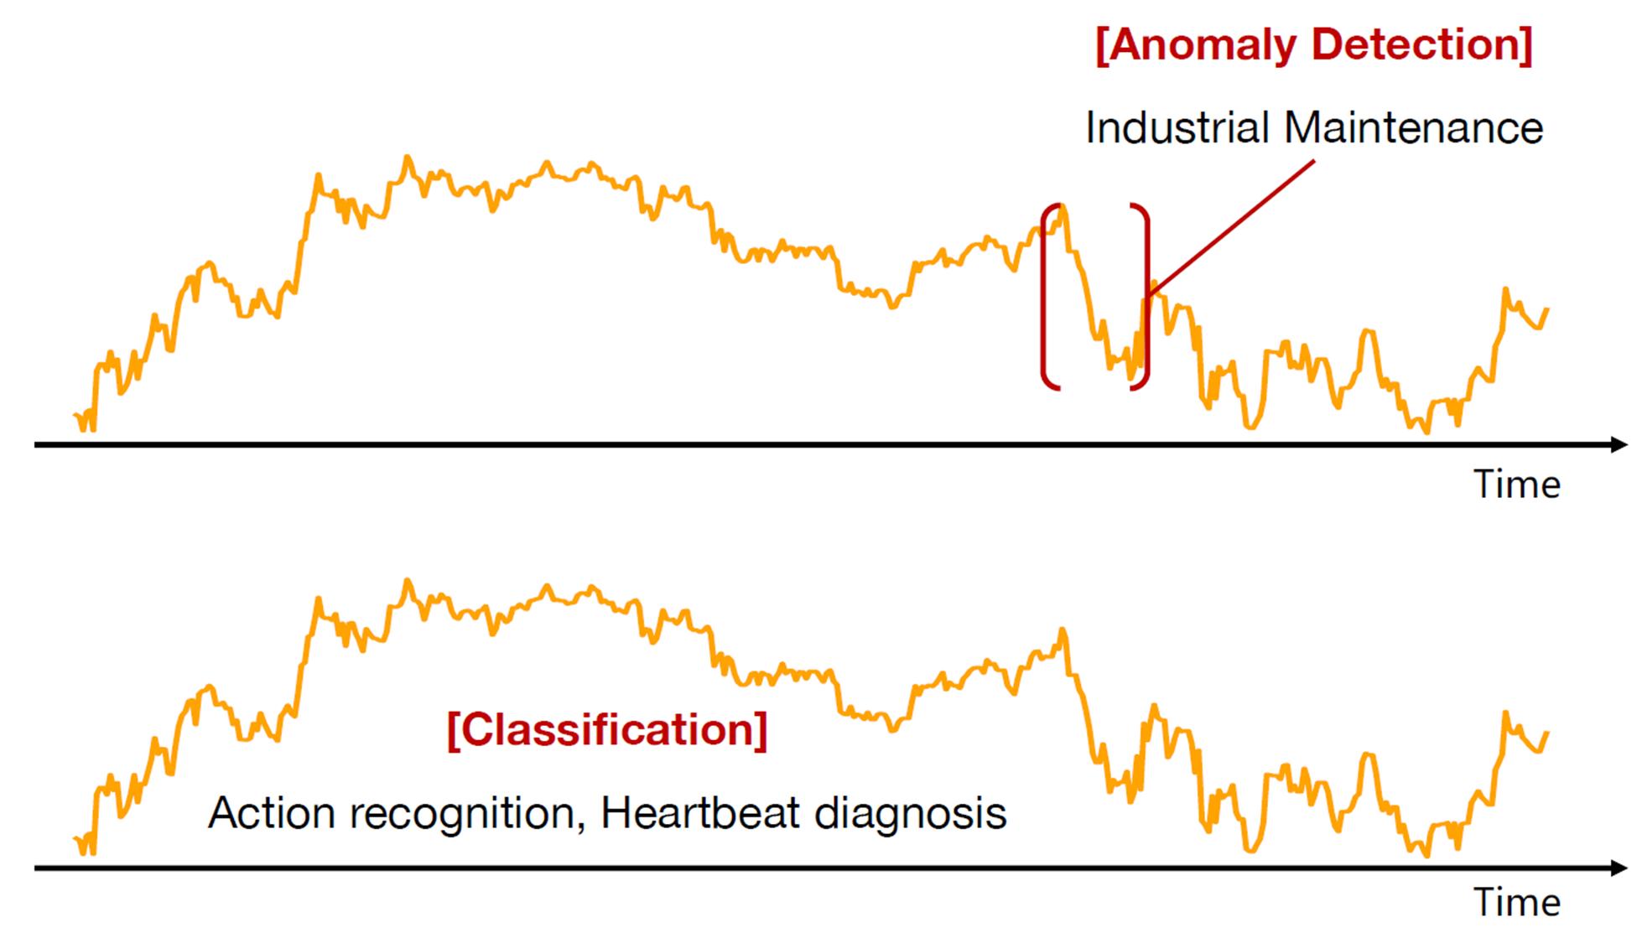
Time-Series Tasks
Forecasting
Long-term Forecasting
Short-term Forecasting
Imputation
Anomaly Detection
Classification
https://wuhaixu2016.github.io/pdf/ICLR2023_TimesNet.pdf

Slide 11
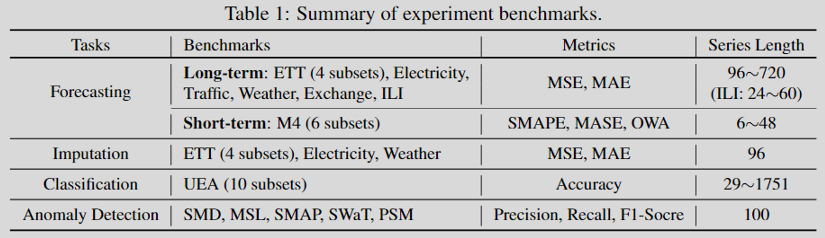
Time-Series Tasks
Haixu Wu, Tengge Hu, Yong Liu, Hang Zhou, Jianmin Wang, & Mingsheng Long (2023). TimesNet: Temporal 2D-Variation Modeling for General Time Series Analysis. In ICLR. OpenReview.net.

Slide 12
Tabular Data ≠ Time Series Data
features
features
f1
f2
f3
f1
f2
f3
time
time
Time can be included in tabular data, but it's often not utilized.
Time must be included in time-series data, and it can be evenly either evenly or irregularly sampled.

Slide 13
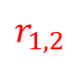

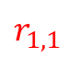
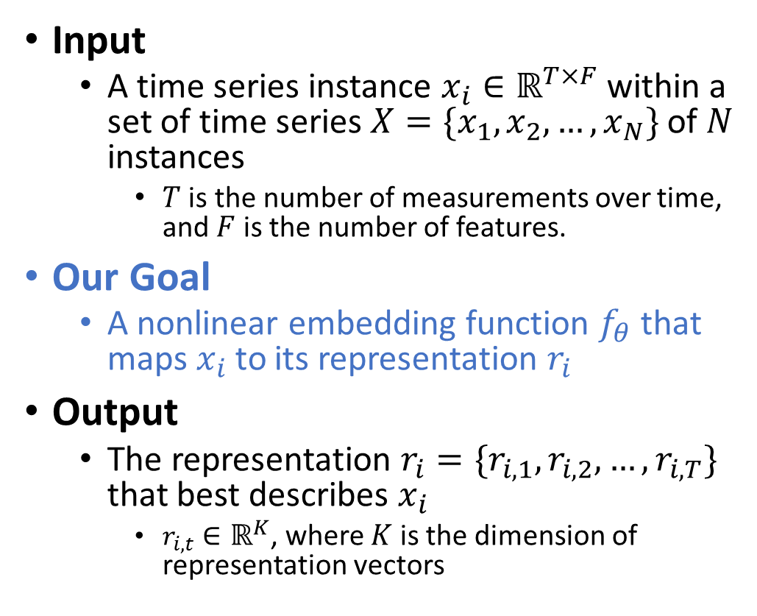
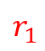
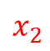
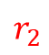
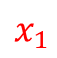
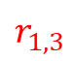
Timestamp-level Representations
features
$$x_{1}$$
Input
A time series instance $x_{i}∈ℝ^{T×F}$ within a set of time series $X=\{x_{1},x_{2}, …,x_{N}\}$ of $N$ instances
$T$ is the number of measurements over time, and $F$ is the number of features.
Our Goal
A nonlinear embedding function $f_{θ}$ that maps $x_{i}$ to its representation $r_{i}$
Output
The representation $r_{i}=\{r_{i,1},r_{i,2}, …,r_{i,T}\}$ that best describes $x_{i}$
$r_{i,t}∈ℝ^{K}$, where $K$ is the dimension of representation vectors
time
$$x_{2}$$
← LLM
$$f_{θ}$$
$$r_{1}$$
$$r_{1,1}$$
$$r_{1,2}$$
$$r_{1,3}$$
$$r_{2}$$

Slide 14
Related Work
Applying LLMs on difference modalities

Slide 15
(FPT) Pretrained Transformers As Universal Computation Engines
The starting point paper to discuss the usage of pretrained LM for non-language tasks
Kevin Lu, Aditya Grover, Pieter Abbeel, & Igor Mordatch (2022). Frozen Pretrained Transformers as Universal Computation Engines. In AAAI (pp. 7628–7636). AAAI Press.

Slide 16
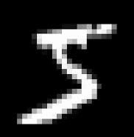
Evaluating Classification Tasks Across Different Modalities
I only list the most representative task.
MNIST/CIFAR-10
Original: 32x32 → 10
Now: 4x4 pixel = 1 image patch, so now we have 8x8 = 64 image patches
Input for GPT-2: 64 tokens of dimension 16

Slide 17
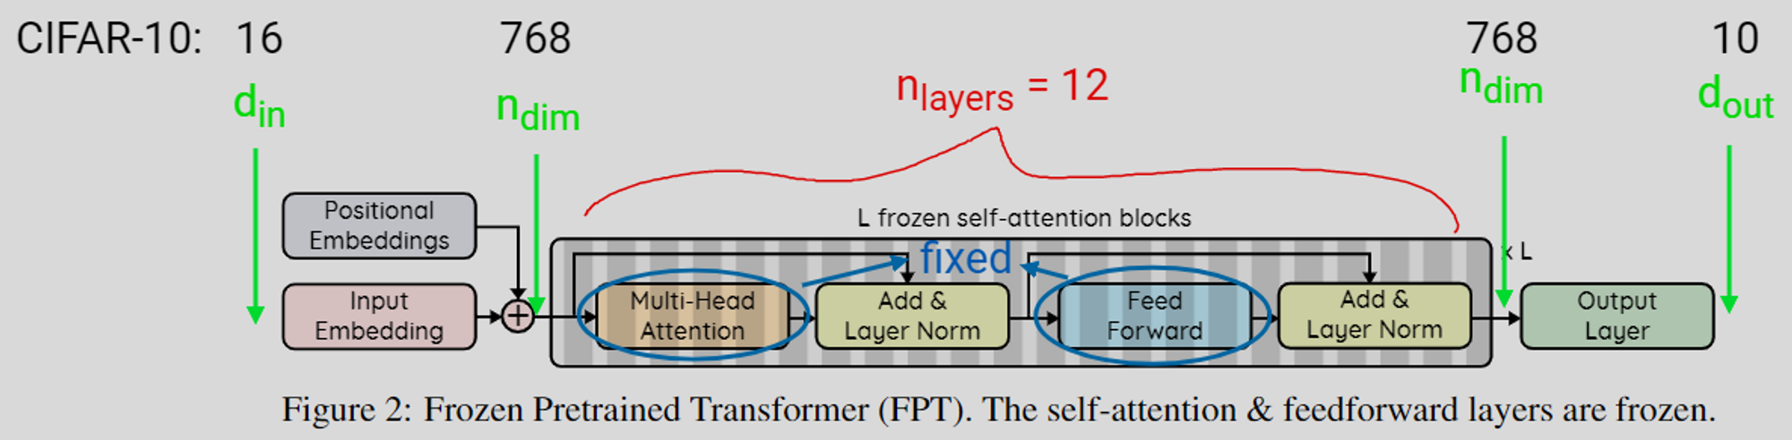
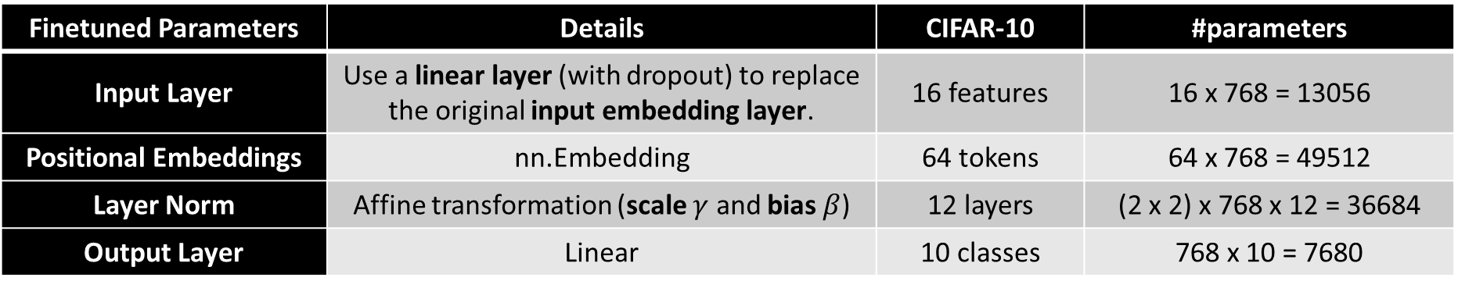
Frozen Pretrained Transformer (FPT)
For the base CIFAR-10 model with 124M parameters, these come out to approximately 0.086% of the network.
Finetuned Parameters | Details | CIFAR-10 | #parameters
Input Layer | Use a linear layer (with dropout) to replace the original input embedding layer. | 16 features | 16 x 768 = 13056
Positional Embeddings | nn.Embedding | 64 tokens | 64 x 768 = 49512
Layer Norm | Affine transformation (scale $γ$ and bias $β$) | 12 layers | (2 x 2) x 768 x 12 = 36684
Output Layer | Linear | 10 classes | 768 x 10 = 7680

Slide 18
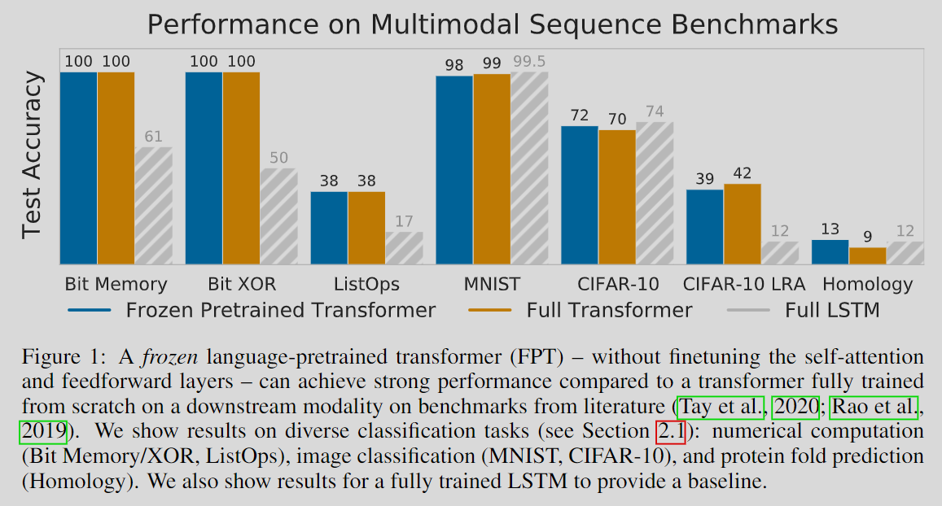
FPT – Results

Slide 19
(GPT4TS) One Fits All: Power General Time Series Analysis by Pretrained LM
Understand how to apply Pretrained LM on time-series
Zhou, Tian, et al. "One Fits All:Power General Time Series Analysis by Pretrained LM." ArXiv, 2023, /abs/2302.11939. Accessed 5 Jul. 2023.

Slide 20
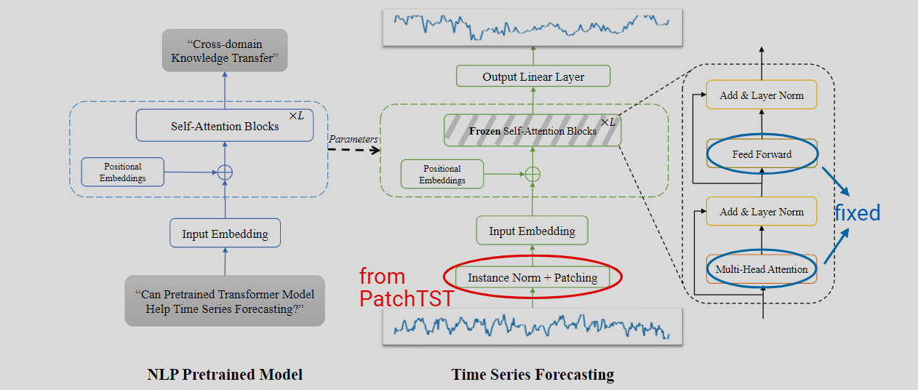
GPT4TS – FPT + PatchTST
Finetuned Parameters
Input Layer
Positional Embeddings
Layer Norm
Output Layer
RevIN
Patching + Channel-independence

Slide 21
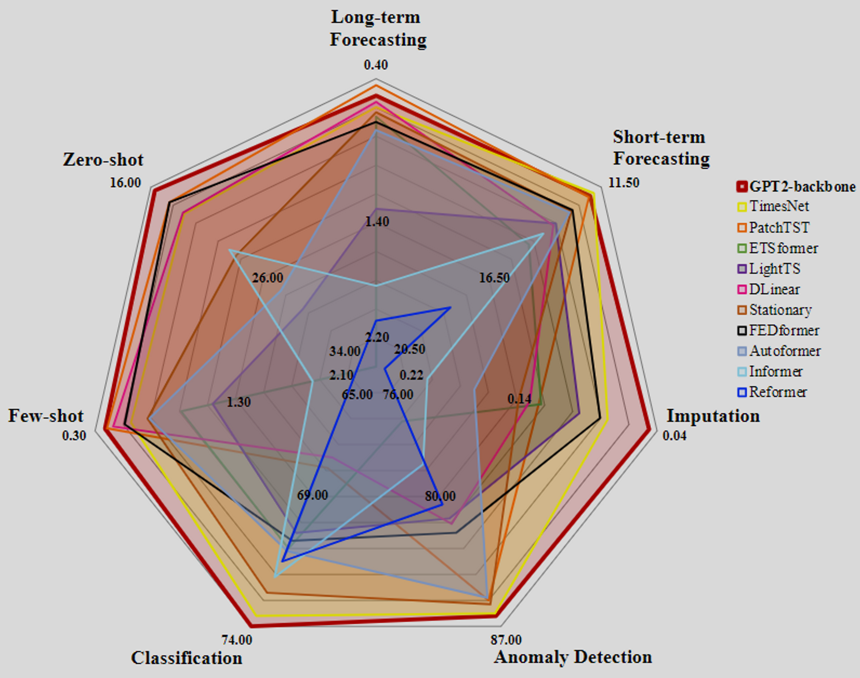
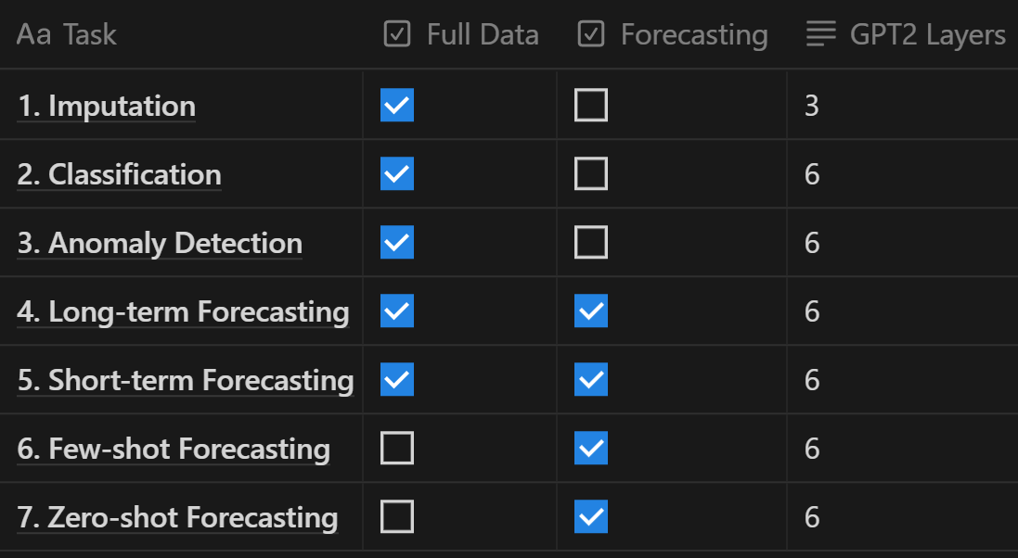
GPT4TS – Results
Main competitor: TimesNet

Slide 22
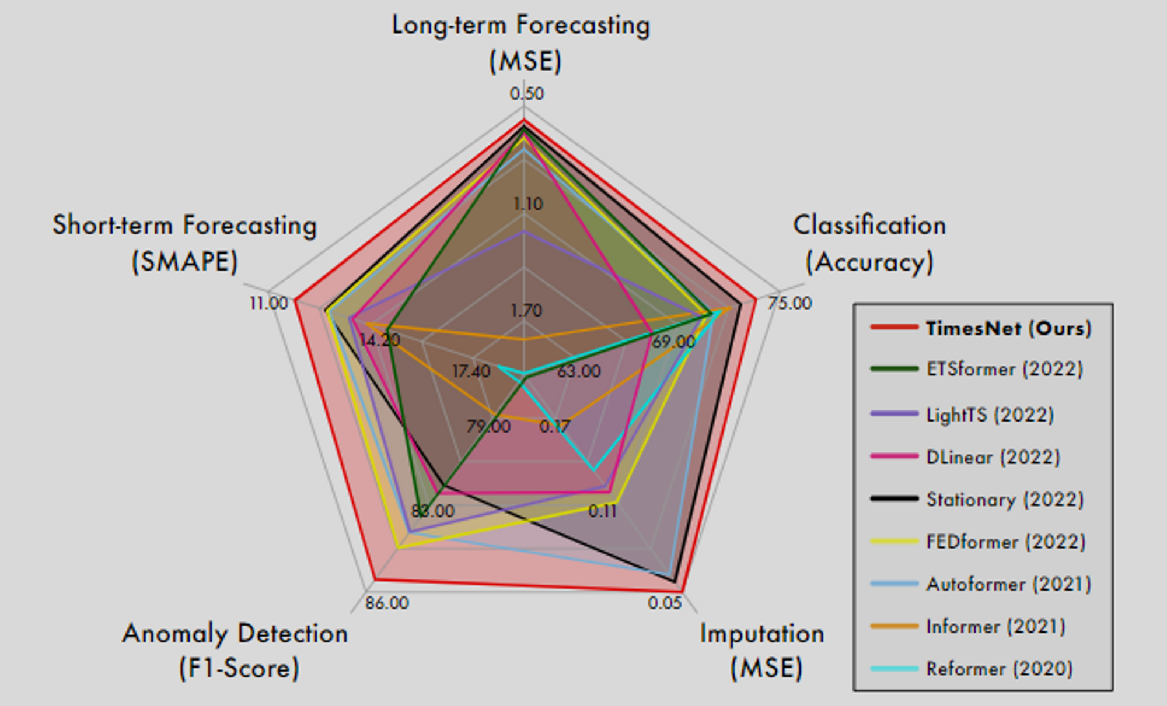
TimesNet

Slide 23
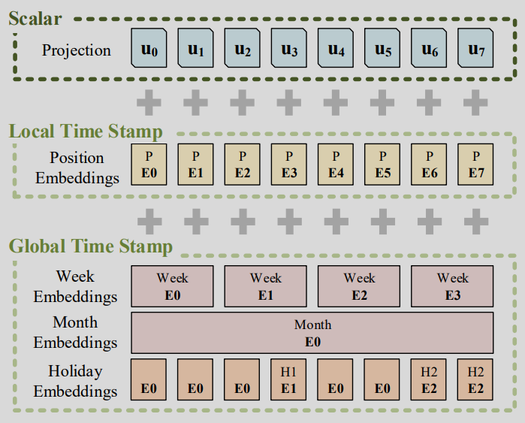
Feeding Multimodal Data into Transformers: Images, Audio, Time-Series, and Tabular Data
(future work)
Input Layer
Output Layer
 | Positional Embedding |  | Input | Output
ViT | Sin/cos, nn.Embedding |  | Patching + Flatten + Linear | Extra learnable [CLS], GAP + Linear
Conformer, Whisper API | Relative sin/cos [Transformer-XL] |  | Conv2d + Linear | Linear + log_softmax
Informer, Autoformer, FEDformer | Positional embedding (sin/cos) | Timestamp embedding (Sin/cos, nn.Embedding) | Conv1dLinear | Linear on C + indexing
PatchTST | Sin/cos (and so many other fixed embeddings) |  | Channel-Independence + Patching+ Linear | Linear on T
GPT4TS | nn.Embedding |  | Channel-Independence + Patching+ Linear | Linear on T

Slide 24
Solution
Still determining the best approach

Slide 25
LLM for Time-Series – 2 Aspects
1. Feeding Time-Series
RevIN (Reversible Instance Normalization)
Data format
Patching + Channel-Independence
Feed Directly
Temporal information
Temporal Embedding
2. PEFT
Norm Tuning
Linear Tuning
Adapter
LoRA
Prefix-tuning
Time-Series Tasks
Forecasting
Long-term
Short-term
Imputation
Anomaly Detection
Classification
LLM
GPT-2
LLaMA

Slide 26
LLM for Time-Series – LLM
1. Feeding Time-Series
RevIN (Reversible Instance Normalization)
Data format
Patching + Channel-Independence
Feed Directly
Temporal information
Temporal Embedding
2. PEFT
Norm Tuning
Linear Tuning
Adapter
LoRA
Prefix-tuning
Time-Series Tasks
Forecasting
Long-term
Short-term
Imputation
Anomaly Detection
Classification
LLM
GPT-2
LLaMA

Slide 27
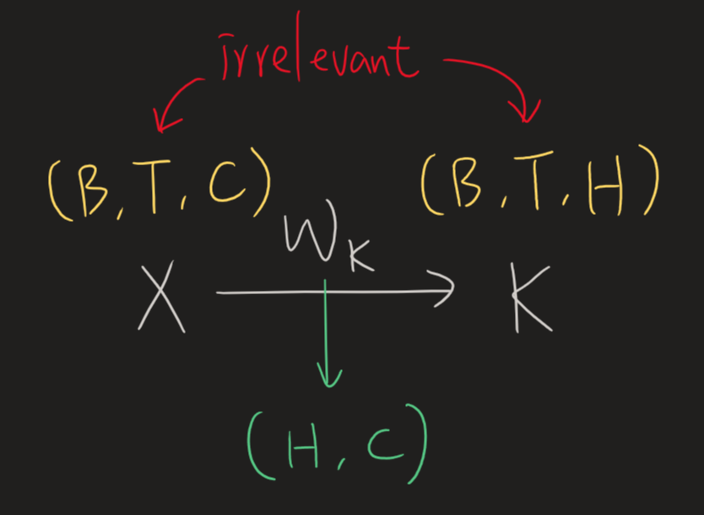
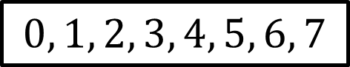

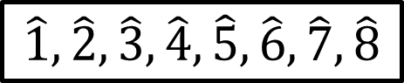

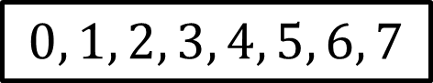
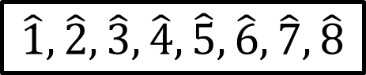
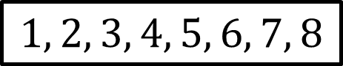
Causal LM – Training vs. Inference
(also known as block_size, n_positions, or max_seq_len)
The context window size won't affect the model size (except for the positional embedding part).
$$\hat{1},\hat{2},\hat{3},\hat{4},\hat{5},\hat{6},\hat{7},\hat{8}$$
$$1, 2, 3, 4, 5, 6, 7, 8$$
loss
$$\hat{1},\hat{2},\hat{3},\hat{4},\hat{5},\hat{6},\hat{7},\hat{8}$$
$$0, 1, 2, 3, 4, 5, 6, 7$$
$$1$$
$$0, 1, 2, 3, 4, 5, 6, 7$$
$$0$$
We'd like the transformer to be accustomed to seeing contexts ranging from as little as one token up to the block size.
Transformers can accept input lengths ranging from 1 to the block size.
True for both training and inference

Slide 28
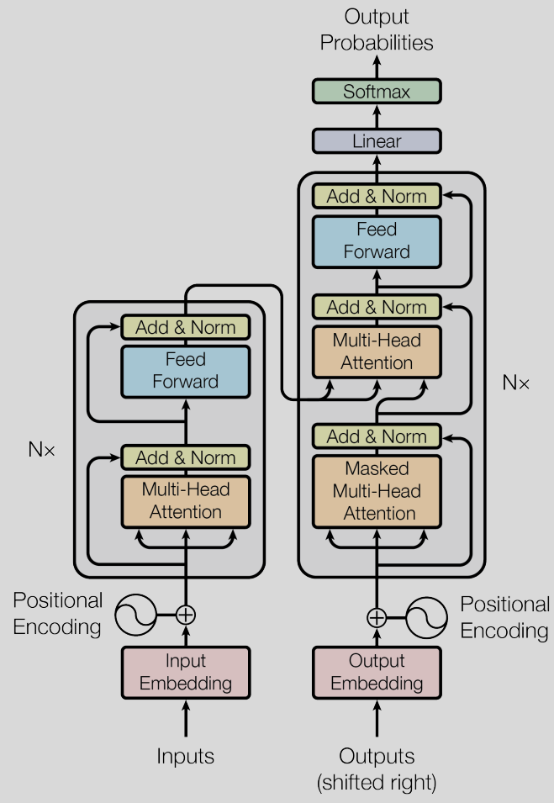
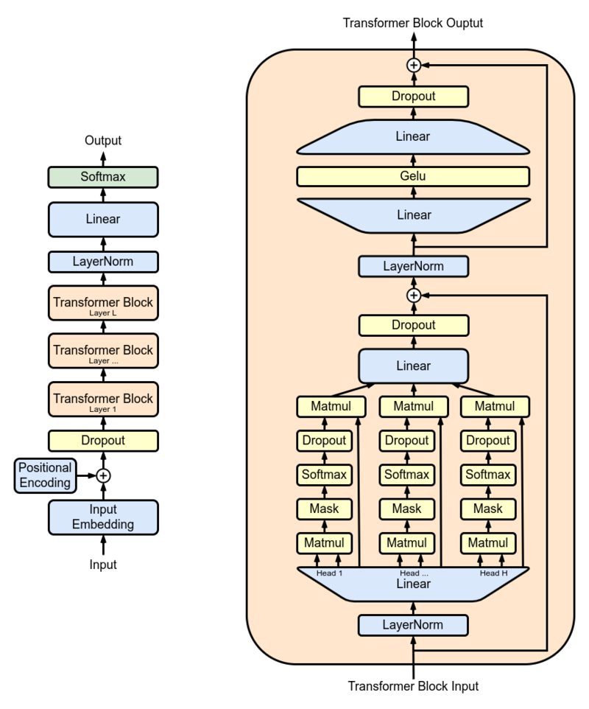
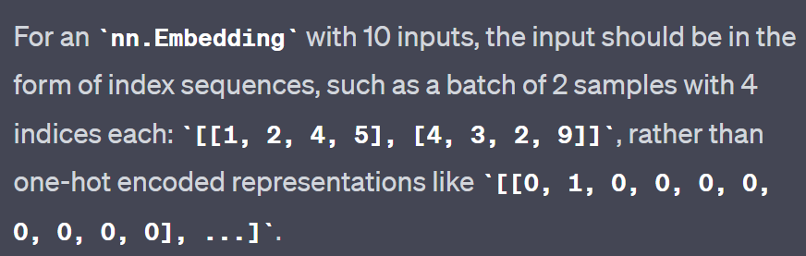
GPT2
Output layer
Hugging Face’s gpt2
(can bypass input embedding by using `inputs_embeds` instead of `input_ids`)
Trainable instead of fixed sinusoidal functions
bypassable
Input layer
Input
`nn.Embedding` is a trainable lookup table, resembling a bias-free linear layer with one-hot inputs.

Slide 29



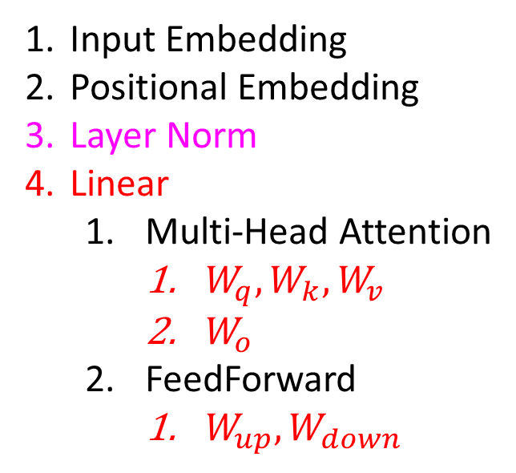

GPT2 – All trainable components
$$W_{down}$$
Output layer
$$W_{up}$$
Hugging Face’s gpt2
(can bypass input embedding by using `inputs_embeds` instead of `input_ids`)
Input Embedding
Positional Embedding
Layer Norm
Linear
Multi-Head Attention
$W_{q},W_{k},W_{v}$
$W_{o}$
FeedForward
$W_{up},W_{down}$
$$W_{o}$$
Trainable instead of fixed sinusoidal functions
bypassable
Input layer
$$W_{q},W_{k},W_{v}$$
`nn.Embedding` is a trainable lookup table, resembling a bias-free linear layer with one-hot inputs.

Slide 30
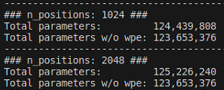
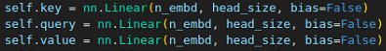
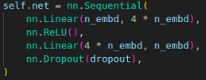
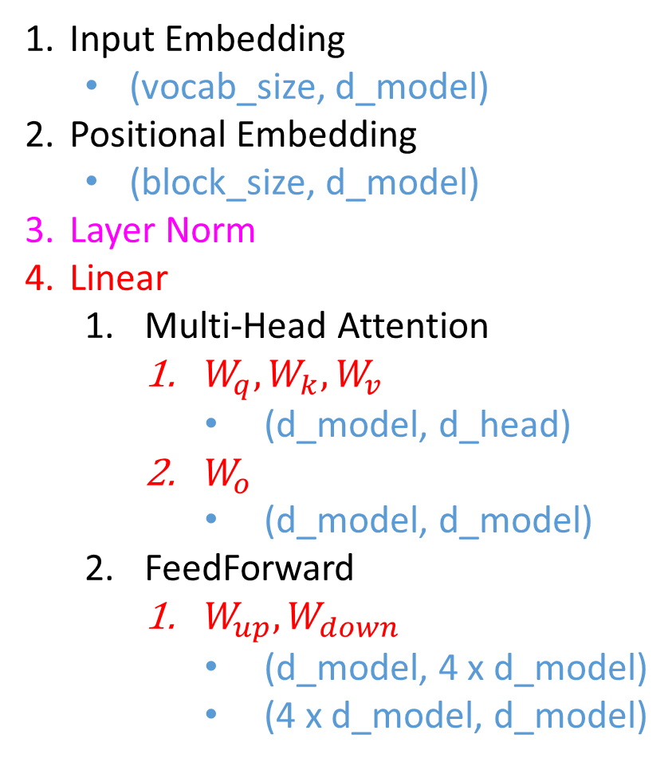
GPT2 – All trainable components
(also known as block_size, n_positions, or max_seq_len)
The context window size won't affect the model size (except for the positional embedding part).
n_embd = d_model
head_size = d_head
Input Embedding
(vocab_size, d_model)
Positional Embedding
(block_size, d_model)
Layer Norm
Linear
Multi-Head Attention
$W_{q},W_{k},W_{v}$
(d_model, d_head)
$W_{o}$
(d_model, d_model)
FeedForward
$W_{up},W_{down}$
(d_model, 4 x d_model)
(4 x d_model, d_model)

Slide 31
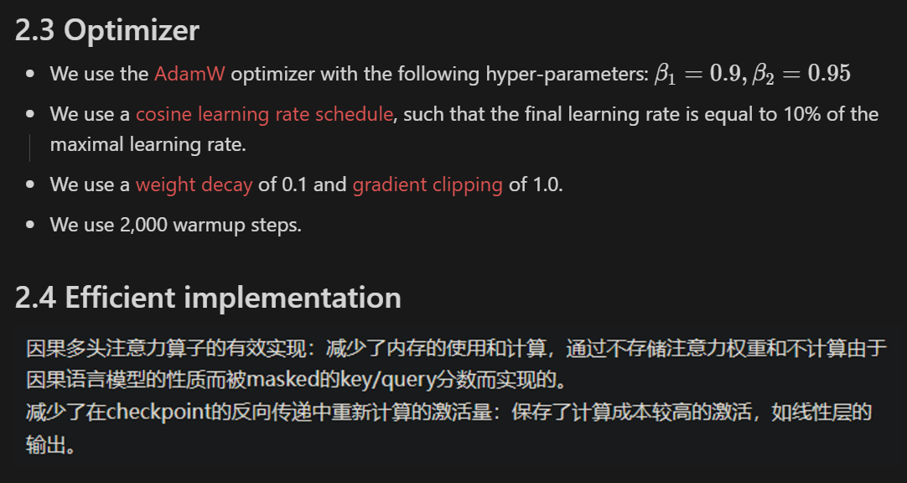
LLaMA – 3 Changes
SwiGLU
Pre-normalization [GPT3]
SwiGLU activation function [PaLM]
Rotary Embeddings [GPTNeo]
RMSNorm
RMSNorm
Rotary Embedding
RMSNorm

Slide 32
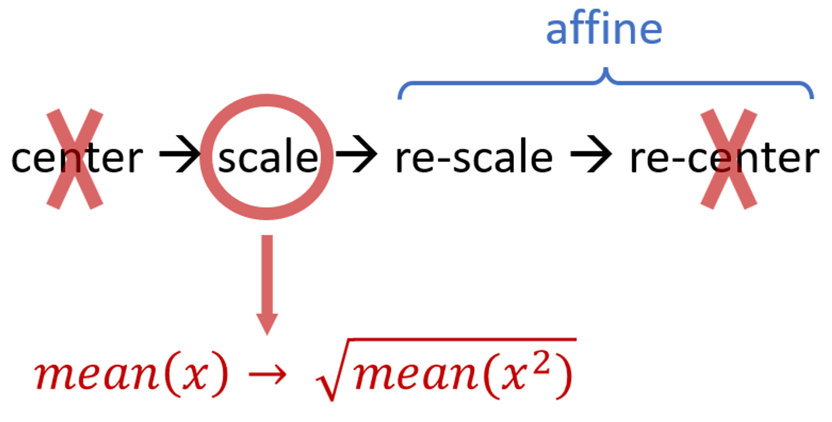
LLaMA – 1. Pre-normalization [GPT3]
We normalize the input of each transformer sub-layer, instead of normalizing the output.
Already in GPT2
We use the RMSNorm normalizing function.
RMSNorm is a simplified LayerNorm.
RMSNorm
RMSNorm
RMSNorm

Slide 33
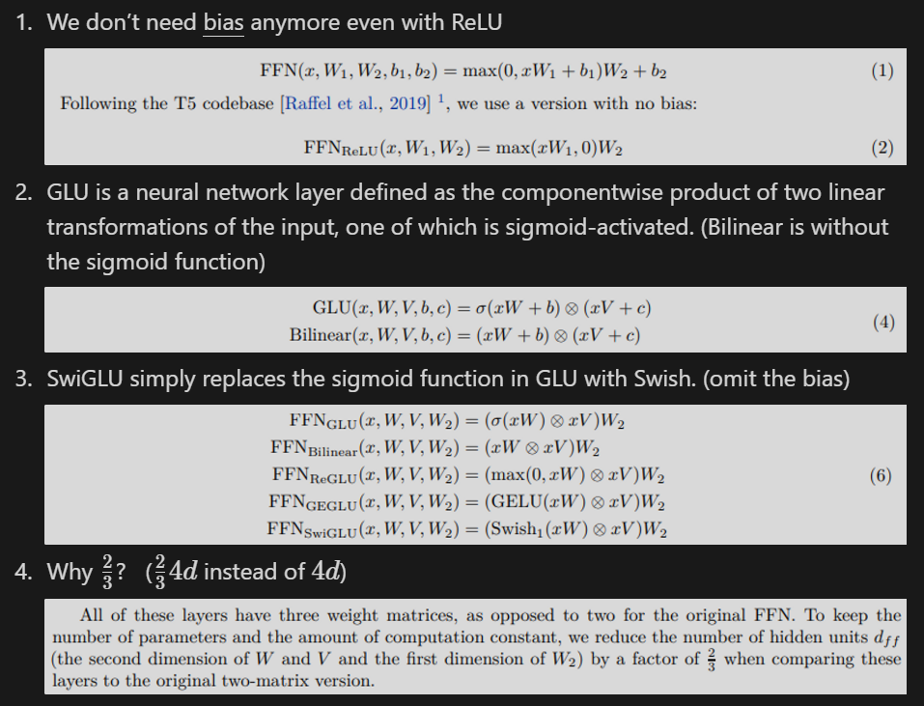
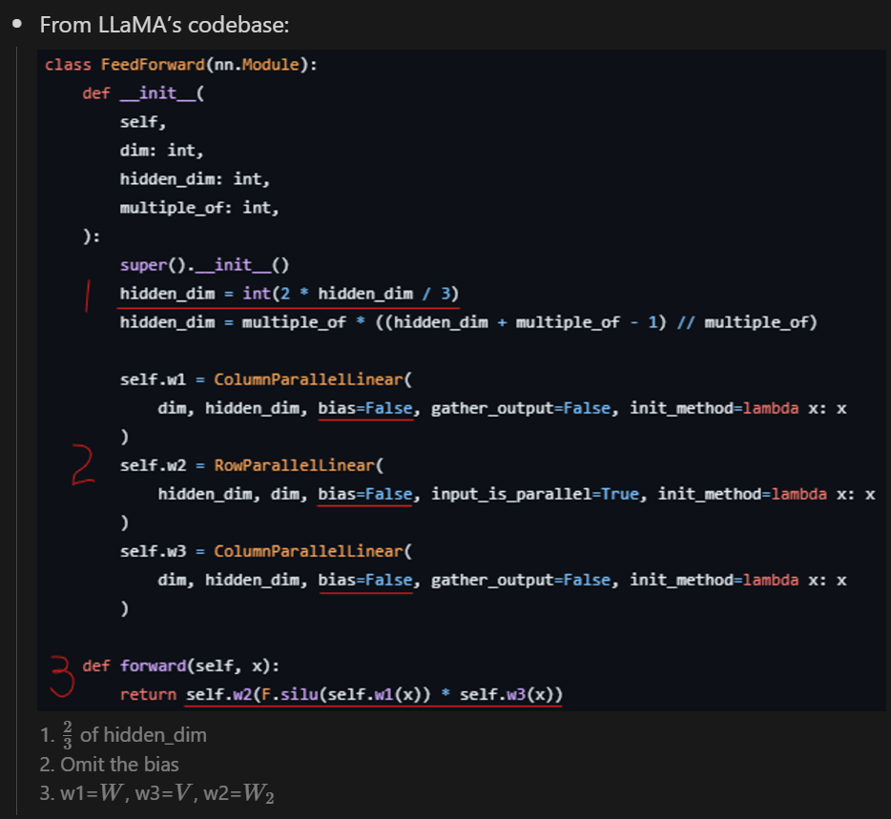
LLaMA – 2. SwiGLU activation function [PaLM]
SwiGLU

Slide 34
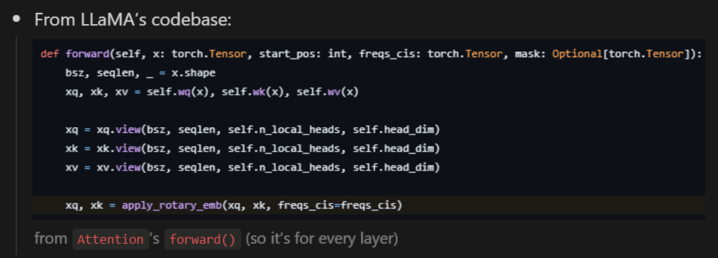
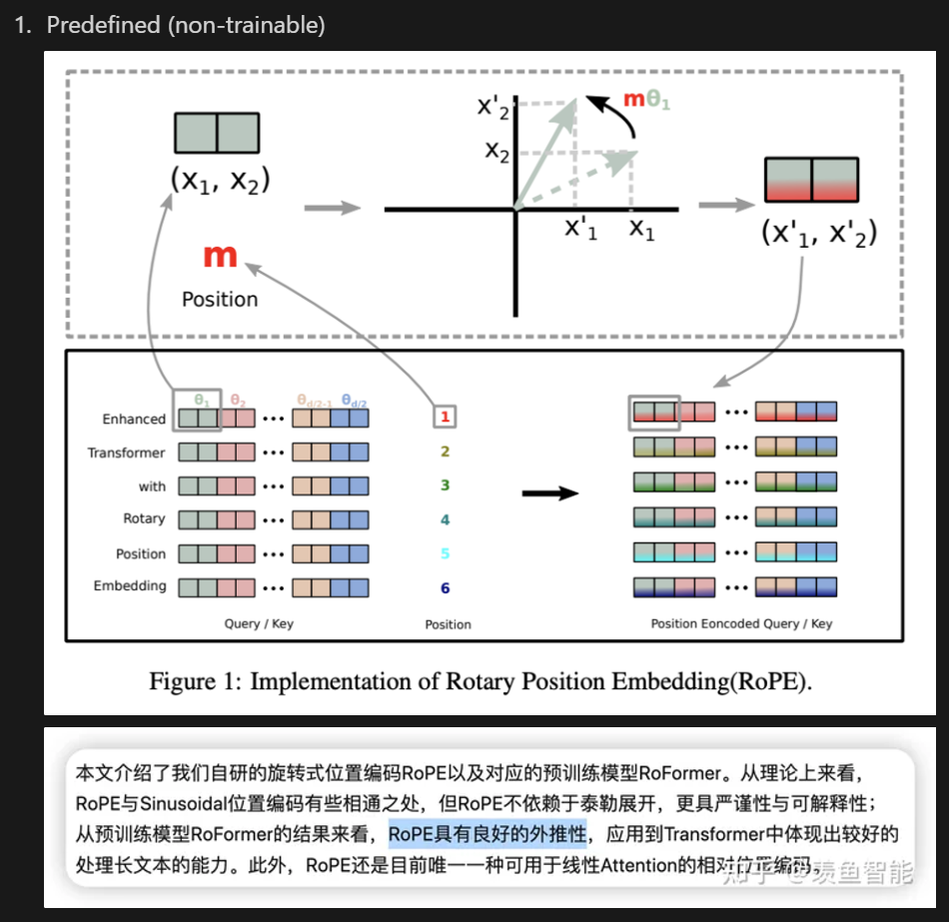
LLaMA – 3. Rotary Embeddings [GPTNeo]
Rotary Embedding

Slide 35
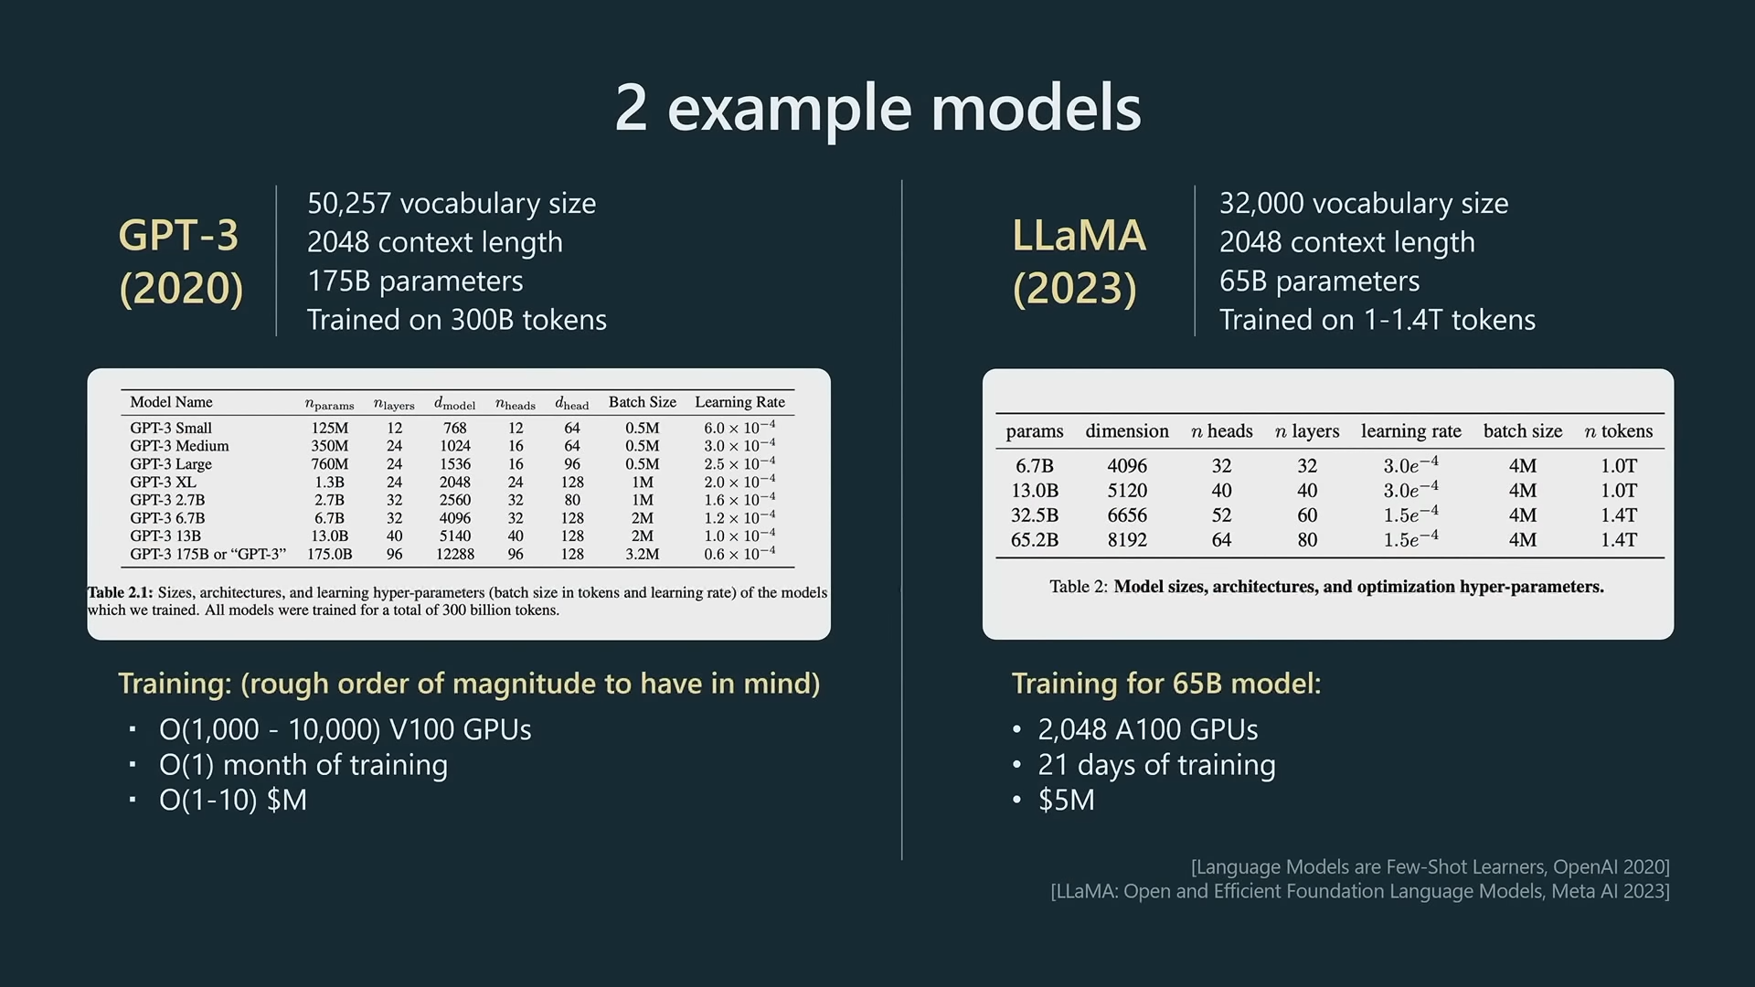
https://build.microsoft.com/en-US/sessions/db3f4859-cd30-4445-a0cd-553c3304f8e2?source=sessions

Slide 36
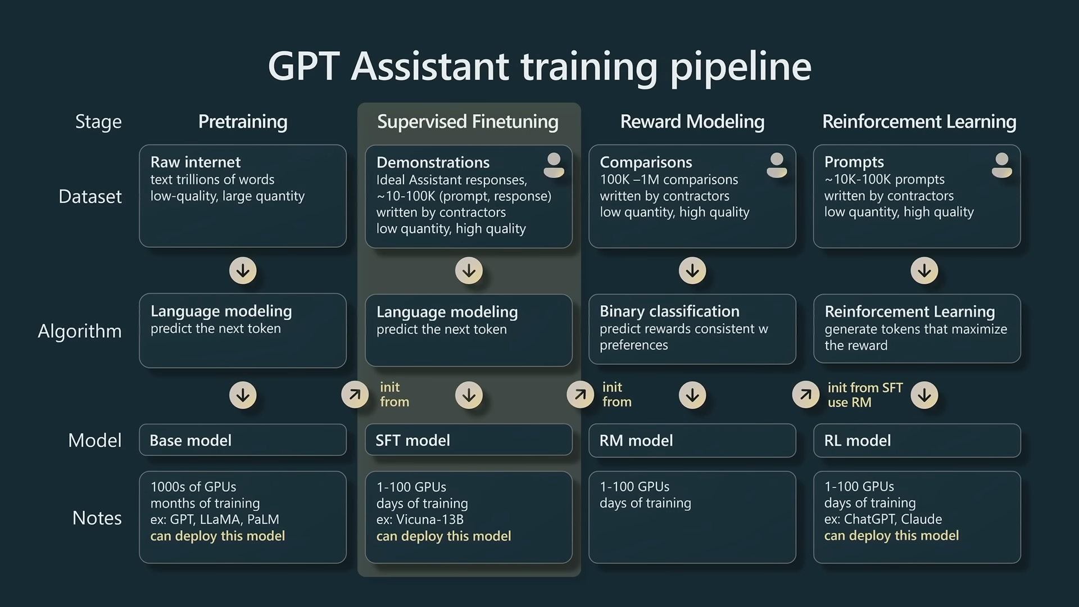
https://build.microsoft.com/en-US/sessions/db3f4859-cd30-4445-a0cd-553c3304f8e2?source=sessions

Slide 37
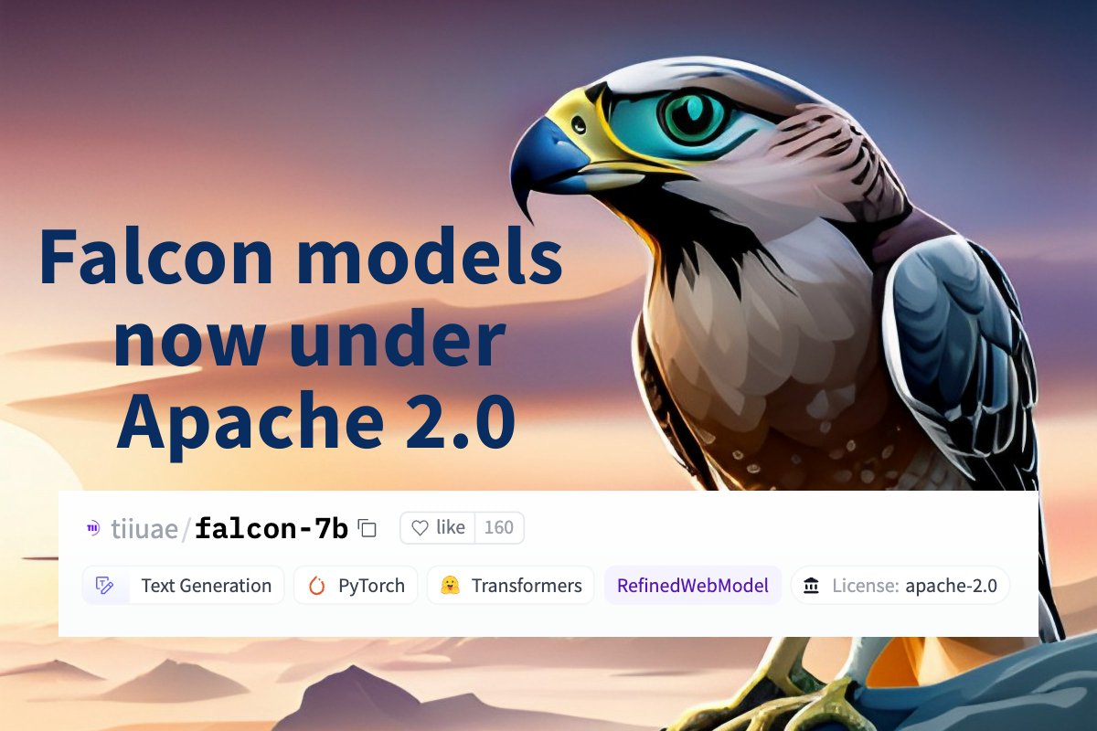
Falcon-7B
“Truly open” model (Apache 2.0 license)
Need ~15GB of GPU memory (Falcon-40B requires ~90GB)
Trained on 1.5T tokens (1T tokens for Falcon-40B)
The key ingredient for the high quality of the Falcon models is their training data, predominantly based (>80%) on RefinedWeb — a novel massive web dataset based on CommonCrawl.
Multiquery Attention
Featuring an architecture optimized for inference, with FlashAttention and multiquery
https://twitter.com/_philschmid/status/1663985494722527235

Slide 38
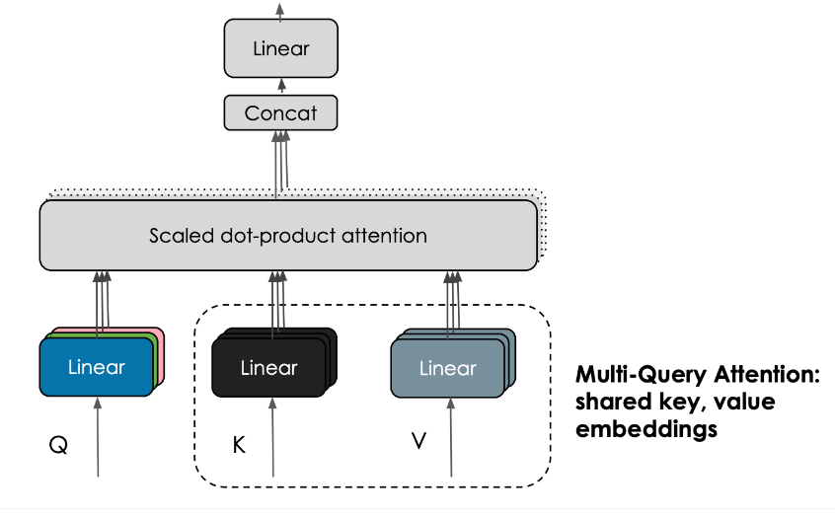
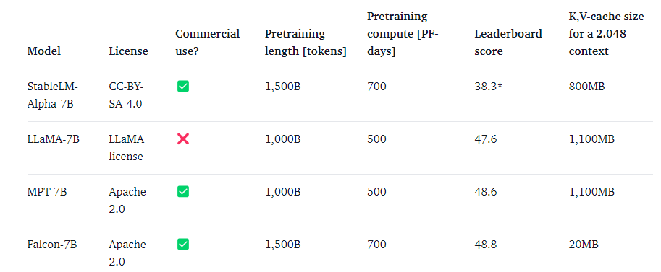
Multiquery Attention
Multi-Query Attention shares one key and value across all heads.
(This trick doesn’t significantly influence pretraining, but it greatly improves the scalability of inference)

Slide 39
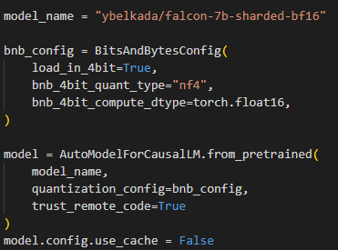


SFT w/ QLoRA
Load model in 4-bit

Slide 40
LLM for Time-Series – Feeding Time-Series
1. Feeding Time-Series
RevIN (Reversible Instance Normalization)
Data format
Patching + Channel-Independence
Feed Directly
Temporal information
Temporal Embedding
2. PEFT
Norm Tuning
Linear Tuning
Adapter
LoRA
Prefix-tuning
Time-Series Tasks
Forecasting
Long-term
Short-term
Imputation
Anomaly Detection
Classification
LLM
GPT-2
LLaMA

Slide 41


RevIN
(B, …, C)
We still apply z-score normalization on our dataset.
dim2reduce
Remove $m_{1},μ_{1},γ_{1},β_{1}$
Hidden layer
Restore $m_{1},μ_{1},γ_{1},β_{1}$
Input layer
Output layer
…
1
2
3
1’
2’
3’
…
1
2
3
1’
2’
3’
…
1
2
3
1’
2’
3’
…
(B, C, T) → (B, C, T)
RevIN_{remove}
(B, C, T) → (B, C, T)
RevIN_{restore}
We apply normalization on each (instance, channel)

Slide 42
Feeding Multimodal Data into Transformers: Images, Audio, Time-Series, and Tabular Data
(future work)
Input Layer
Output Layer
Patching + Channel-Independence
Feed Directly
 | Positional Embedding |  | Input | Output
ViT | Sin/cos, nn.Embedding |  | Patching + Flatten + Linear | Extra learnable [CLS], GAP + Linear
Conformer, Whisper API | Relative sin/cos [Transformer-XL] |  | Conv2d + Linear | Linear + log_softmax
Informer, Autoformer, FEDformer | Positional embedding (sin/cos) | Timestamp embedding (Sin/cos, nn.Embedding) | Conv1dLinear | Linear on C + indexing
PatchTST | Sin/cos (and so many other fixed embeddings) |  | Channel-Independence + Patching+ Linear | Linear on T
GPT4TS | nn.Embedding |  | Channel-Independence + Patching+ Linear | Linear on T

Slide 43

Channel-Independence

Slide 44










1. Patching
3.
(B, C, T_{P}, P)
B’
(w/ Channel Independence)
…
$$T$$
…
$$C$$
$$N$$
$$=T_{P}$$
2.
$$N$$
…
…
$$P$$
$$S$$
$$P$$
4.
Encoding (token + pos)
Linear/
Conv1D
1.
It won’t be larger than $S$
$$N=\left\lfloor \frac{(T−P)}{S}\right\rfloor +2$$
…
Linear on T
$$D$$
(B, C, T_{P}, D)
B’

Slide 45
1. Patching
3.
(B, C, T_{P}, P)
B’
(w/ Channel Independence)
…
$$T$$
…
$$C$$
$$N$$
$$=T_{P}$$
2.
$$N$$
…
…
$$P$$
$$S$$
$$P$$
4.
Encoding (token + pos)
Linear/
Conv1D
1.
It won’t be larger than $S$
$$N=\left\lfloor \frac{(T−P)}{S}\right\rfloor +2$$
…
Linear on T
$$D$$
(B, C, T_{P}, D)
B’

Slide 46

2. Feed Directly
$$T$$
$$C$$
Encoding (token + pos)
Linear/
Conv1D
…
$$D$$
Linear on D
(B, T, D)

Slide 47
How do we use temporal embedding?
Feed Directly vs. Patching
token
token
encoding
token_emb
token
patching
patched_token
token
encoding
token_emb
+
+
pos
pos
encoding
pos_emb
patched_pos
pos
encoding
pos_emb
temp
temp
encoding
temp_emb
patched_temp
temp
encoding
temp_emb

Slide 48



Patching with Temporal Embedding
(w/ Channel Independence)
B’
B’
Flatten + Linear
(BxC, T_{p} , P, C_{t})
(BxC, T_{p}, D)
$$T$$
We need to devise a method to aggregate timestamps and time infos.
$$C$$
2. For each timestamp, we have multiple time infos.
$$N$$
$$=T_{P}$$
day
$$N$$
$$=T_{P}$$
week
month
…
1
2
.
.
16
9
10
.
.
24
17
18
.
.
32
1
2
.
.
16
9
10
.
.
24
17
18
.
.
32
…
$$P$$
…
$$P$$
1. For each position, we have multiple timestamps.

Slide 49
Patching with Supervised Finetuning
(w/ Channel Independence)
$$T$$
$$C$$
B’
B’
$$N$$
$$=T_{P}$$
Input Layer + LLM + Output Layer
(BxC, T_{p} , P)
(BxC, T_{p} , P)
1
2
.
.
16
9
10
.
.
24
17
18
.
.
32
9
10
.
.
24
17
18
.
.
32
25
26
.
.
40
…
$$P$$
…
0 1 2 1023
1 2 3 1024

Slide 50
Patching + Channel-Independence
1
2
.
16
9
10
.
24
17
18
.
32
…
(B, T_{in} , C)
(B * C, T_{p} , P)
Input Layer
_{SFT}
Supervised
Finetuning
…
(B * C, T_{p} , D)
_{DFT}
Downstream
Finetuning
RevIN_{DFT}
RevIN_{SFT}
LLM + PEFT
…
(B * C, T_{p} , D)
Flatten (B * C, T_{p} * D)
Linear (B * C, T_{out})
Dropout
Rearrange (B, T_{out}, C)
Linear (B * C, T_{p} , P)
Dropout
Output Layer_{DFT}
Output Layer_{SFT}
9
10
.
24
17
18
.
32
25
26
.
40
…
(B, T_{out} , C)
(B * C, T_{p} , P)

Slide 51
LLM for Time-Series – PEFT
1. Feeding Time-Series
RevIN (Reversible Instance Normalization)
Data format
Patching + Channel-Independence
Feed Directly
Temporal information
Temporal Embedding
2. PEFT
Norm Tuning
Linear Tuning
Adapter
LoRA
Prefix-tuning
Time-Series Tasks
Forecasting
Long-term
Short-term
Imputation
Anomaly Detection
Classification
LLM
GPT-2
LLaMA

Slide 52

PEFT Methods
Augmenting the existing pre-trained model with extra parameters or layers
Selecting existing parameters or layers
Leveraging low-rank representations to minimize the number of trainable parameters
Lialin, Vladislav, Vijeta Deshpande, and Anna Rumshisky. "Scaling down to scale up: A guide to parameter-efficient fine-tuning." arXiv preprint arXiv:2303.15647 (2023).

Slide 53

UniPELT – 3 PEFT tricks
Adapter
Prefix-tuning
LoRA

Slide 54



UniPELT – 1. Adapter
$$h_{A}^{′}=𝓖_{A}h_{A}+h_{F}$$
$$h_{A}=W_{up}^{T}φ(W_{down}^{T}h_{FN})$$
bottleneck layer
Gating mechanism for not using the bottleneck layer
Residual connection for using original input
Using the direct input $h_{FN}$ using a feedforward network with sigmoid activation

Slide 55




UniPELT – 2. Prefix-tuning
$$Q, K, V$$
Two prefix matrices $P_{K}$ and $P_{V}$ are prepended to $K$ and $V$.
Gating mechanism for not using the $P_{K}$ and $P_{V}$
Using the input $h_{in}$ using a feedforward network with sigmoid activation

Slide 56

UniPELT – 2. Prefix-tuning
$$Q, K, V$$

Slide 57


UniPELT – 3. LoRA
$$W_{Q}, W_{K}, W_{V}$$
$$Q=\left(W_{Q}^{T}+𝓖_{L}W_{up}^{T}W_{down}^{T}\right)h_{in}$$
bottleneck layer
Gating mechanism for not using the bottleneck layer
Using the input $h_{in}$ using a feedforward network with sigmoid activation

Slide 58


LLaMA-Adapter
In the LLaMA model with 7B parameters, the LLaMA-Adapter fine-tunes 1.2M, or approximately 0.017%, of the network.
V1
Learnable Adaption Prompts
They use real virtual tokens, multiply them by $W_{k}$ and $W_{v}$ for the corresponding $K$ and $V$.
Unlike UniPELT's method of stabilizing training with additional MLP
Zero-init Attention
This mechanism uses learnable, zero-initialized parameters passed through tanh
Unlike UniPELT's neural network gating strategy
V2
Bias Tuning of Linear Layers
They also unfreeze normalization layers.

Slide 59



LLaMA-Adapter – 3. Bias Tuning of Linear Layers
All linear layers in LLaMA
SwiGLU
$$W, V, W_{2}$$
($W_{1},W_{2},W_{3}$)
$$W_{o}$$
$$W_{q},W_{k},W_{v}$$

Slide 60
LLM for Time-Series – Supervised Finetuning
This can only be applied when feeding directly.
This can only be applied to a consecutive dataset (without breakpoints).
1. Feeding Time-Series
RevIN (Reversible Instance Normalization)
Data format
Patching + Channel-Independence
Feed Directly
Temporal information
Temporal Embedding
2. PEFT
Norm Tuning
Linear Tuning
Adapter
LoRA
Prefix-tuning
Time-Series Tasks
Forecasting
Long-term
Short-term
Imputation
Anomaly Detection
Classification
LLM
GPT-2
LLaMA
2.
1.
AutoRegressive

Slide 61
2 Directions
Basics:
RevIN
Positional Encoding Tuning
Norm Tuning
Supervised Finetuning
1.
2. PEFT
LoRA
Prefix Tuning
P-Tuning
Prompt Tuning
AdaLoRA
Adaption Prompt
Time-Series Tasks
Forecasting
Long-term
Short-term
Imputation
1. Feeding Time-Series
Feed Directly
Temporal Embedding
LLM
GPT-2
LLaMA
2.
2. PEFT
LoRA
Prefix Tuning
P-Tuning
Prompt Tuning
AdaLoRA
Adaption Prompt
Time-Series Tasks
Forecasting
Long-term
Short-term
Imputation
Anomaly Detection
Classification
1. Feeding Time-Series
Patching + Channel-Independence
Temporal Embedding with Patching
LLM
GPT-2
LLaMA

Slide 62
Hyperparameters for PEFT
PEFT
LoRA | r = {8, 16, 32} | lora_alpha = {16, 32, 64} | lora_dropout = {0, 0.01, 0.1, 0.2} | bias={“none”, “all”}
Prefix Tuning
P-Tuning
Prompt Tuning
AdaLoRA
Adaption Prompt | r = {8, 16, 32} | lora_alpha = {16, 32, 64} | lora_dropout = {0, 0.01, 0.1, 0.2}

Slide 63
2 Directions
Basics:
RevIN
Positional Encoding Tuning
Norm Tuning
Supervised Finetuning
1.
1. Feeding Time-Series
Feed Directly/Patching
With/Without Temporal Embedding
Time-Series Tasks
Forecasting
Long-term
Short-term
Imputation
LLM
GPT-2
LLaMA
2. PEFT
None/LoRA/ AdaLoRA
2.

Slide 64
2 Strategies for Time-Series Forecasting
Flatten
GAP
Last
Simultaneous Multi-Step Forecasting
Autoregressive One-Step-Ahead Forecasting
Multiple outputs
Teacher-forcing (Training)
Free-running (Inference)
Single output

Slide 65
Final Direction – Feed Directly
Basics:
RevIN
Positional Encoding Tuning
Norm Tuning
Supervised Finetuning
1.
1. Feeding Time-Series
Feed Directly
With Temporal Embedding
Time-Series Tasks
Forecasting
Long-term
Short-term
Imputation
LLM
GPT-2 (base)
LLaMA-7B
Falcon-7B
2. PEFT
LoRA/AdaLoRA
Prefix-Tuning
2.
AutoRegressive
Simultaneous
Flatten
GAP
Last

Slide 66
Final Direction – Patching
Basics:
RevIN
Positional Encoding Tuning
Norm Tuning
Supervised Finetuning
1.
Time-Series Tasks
Forecasting
Long-term
Short-term
Imputation
Anomaly Detection
Classification
1. Feeding Time-Series
Patching
With Temporal Embedding
LLM
GPT-2 (base)
LLaMA-7B
Falcon-7B
2. PEFT
LoRA/AdaLoRA
Prefix-Tuning
2.

Slide 67

ETTh1

Slide 68
Thanks for your attention

